Slide 1
Software Engineering
SOFTWARE PROJECT MANAGEMENT

Slide 2
Software Project Management
Software Engineering
Project Management
Software & Project Management
Corporate America spends more than $275 billion each year on approximately 200,000 application software development projects
Most of these projects will fail for lack of skilled project management
Management problems were more frequently dominant cause than technical problems
Schedule overruns were more common (89%) than cost overruns (62%)
KPGM’s Survey in UK

Slide 3
Software Project Management (2)
Software Engineering
Project Management
Success Factors
User involvement – 20 points
Executive Support – 15 points
Clear Business Objectives – 15 points
Experienced Project Manager – 15 points
Small milestones – 10 points
Firm basic requirements – 5 points
Competent staff – 5 points
Proper planning – 5 points
Ownership – 5 points
Others – 5 points

Slide 4
Software Project Management (3)
Software Engineering
Project Management
Primary causes of software runaway
Project Objectives not fully specified
Bad planning and estimating
Technology new to the organization
Inadequate/No project management methodology
Insufficient senior staff on the team
Poor performance by Supplier of hardware/software

Slide 5
In a nutshell
Software Engineering
Project Management
“Organizations that attempt to put software engineering discipline in place before putting project management discipline in place are domed to fail”
SEI

Slide 6
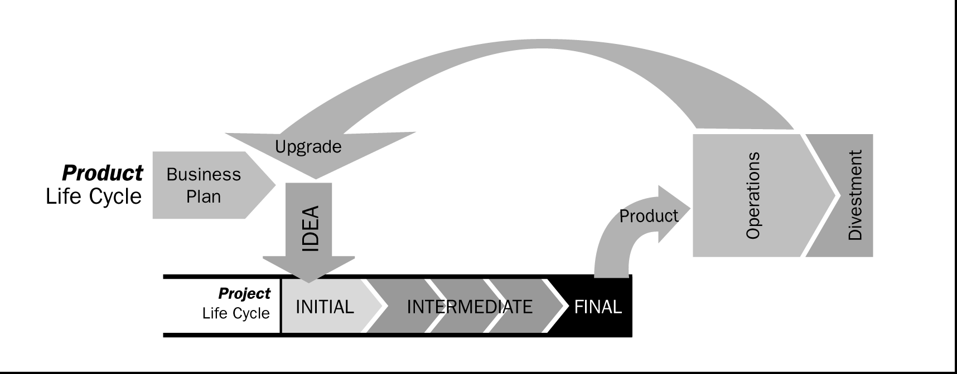
Product and the Project Life Cycles
Software Engineering
Project Management

Slide 7
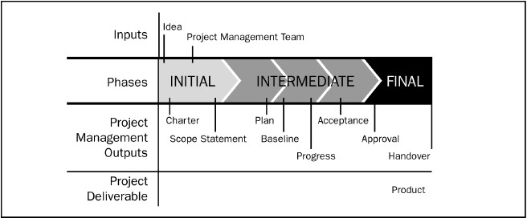
Phases in a Project Life Cycle
Software Engineering
Project Management

Slide 8
Project Management Life Cycle Processes/Activities of the 5 phases (Process Groups 2004) are as:
1. Scope the Project
State the Problem/ Opportunity
Establish the project goal
Define project Objectives
Identify the success criteria
List assumptions, risks, obstacles
2. Develop detail Plan
Identify project activities
Estimate activity duration
Determine resource requirements
Construct / analyze project network
Prepare project proposal
3. Launch the Plan
Recruit and organize project team
Establish team operating rules
Level resources
Schedule work packages
Document work packages
4. Monitor/ Control Progress
Establish progress reporting system
Install change control tools/process
Define problem-escalation process
Monitor project progress vs plan
Revise Plan
5. Close Out
Obtain client acceptance
Install project deliverables
Complete project documentation
Complete post-implementation audit
Issue final project report

Slide 9
Software Engineering
Project Management
Knowledge Areas for Project Management
Project Integration Management
Project Scope management
Project Time Management
Project Cost Management
Project Quality Management
Project Human Resource Management
Project Communications Management
Project Risk Management
Project Procurement Management
9

Slide 10
Mapping PM processes to Process Groups (Life Cycle Phases)
Phases PM Knowledge | Initiating | Planning | Executing | Controlling | Closing
Integration ^{De} Management (7) ^{De} sc | velop charter velop primary ope statement | , Develop project management plan | Direct and manage project Execution | Monitor and Control project work, Integrated change control | Close Project
Scope management (5) |  | Scope planning, Scope definition, Create WBS |  | Scope Verification, Scope Change Control
Time Management (6) |  | Activity definition, Act Sequencing, Act Resource Estimating, Act duration Est, Schedule Dev. |  | Schedule control
Cost Management (3) 44 | PM pro | Cost Estimating _{c}C_{e}o_{s}st_{s}B_{e}ud_{s}ge_{t}t_{o}ing_{the} | 5 PM Pro | Cost control cess Groups
Quality Management (3) |  | Quality planning | Perform Quality Aªc^{s}q^{s}u^{u}i^{ran}P^{c}r^{e}oject | Perform Quality control
Human Resource |  | Human Resource Planning | Team, Develop Project Team | Manage Project Team | 10

Slide 11
Mapping PM processes to Life Cycle Phases…
PM Knowledge | Initiatin g | Planning | Executing | Controlling | Closing
Communicatons Management (4) |  | Comm. Planning | Information Distribution | Performance reporting,
 |  |  |  | Manage Stakeholders
Risk Management (6) |  | Risk Management Planning, |  | Risk monitoring & control
 |  | Risk identification,
 |  | Qualitative Risk analysis,
 |  | Qualitative Risk analysis , Risk response planning
Procurement |  | Plan Purchases | Request | Contract | Contract
Management (6) |  | and Acquisitions, | Seller | Administration | Closure
 |  | Plan Contracting | Responses,
 |  |  | Select Seller

Slide 12
Software Project Planning
Software Engineering
Project Management
The purpose of the Project Plan is to define and establish the management strategy for achieving the goals of the project.
The project development plan is used to:
Guide project execution.
Document project planning assumptions.
Document project planning decisions regarding alternatives chosen.
Facilitate communication among stakeholders.
Define key management reviews (as to content, extent, and timing).
Provide a baseline for progress measurement and project control.

Slide 13
Software Engineering
Project Management
Detailed Plan Development
Inputs
Other planning outputs
Outputs of the planning processes in the other knowledge areas (scope, Time, Risk, Resource, Cost….)
Historical information
Estimating databases, records of past project performance
Organizational policies
Formal and informal policies including
Quality management
Personnel management
Financial controls
Constraints
Factors that limit the team’s options
Assumptions
Factors that are considered true, real or certain
Outputs
Project Plan (Proposal)
Supporting Details
•

Slide 14
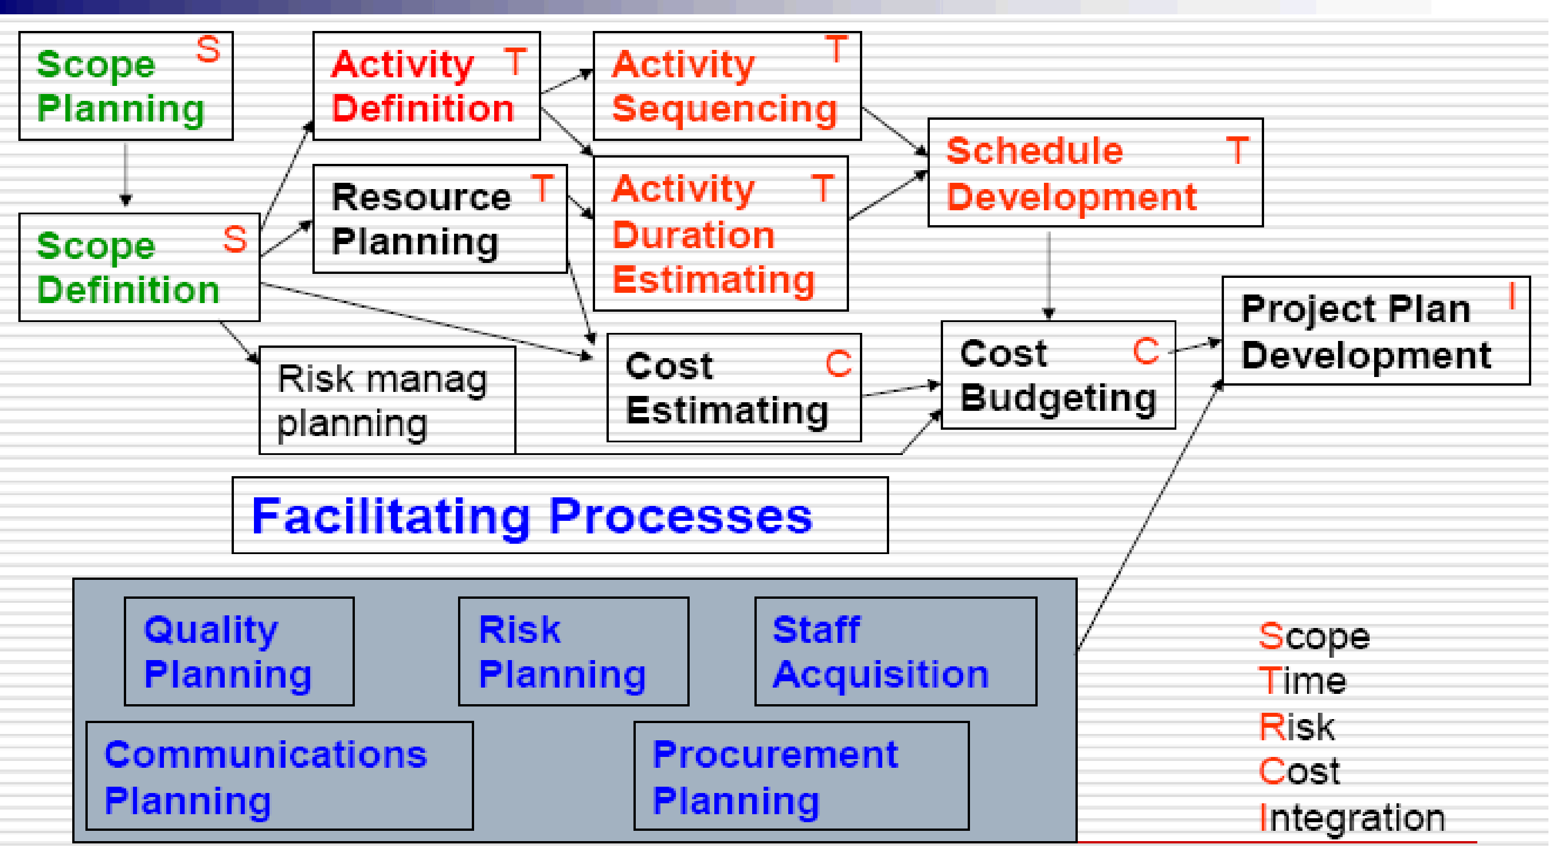
Planning Process Flow
Software Engineering
Project Management

Slide 15
Software Engineering
Project Management
The Project Plan
Contents
Many format; common sections are: (kathy -62)
Introduction or Overview
Project Name, Description and Need it addresses, Sponsor's name, Name of PM, Deliverables (Brief), Reference Material, List of definitions.
Project Organization
Org. chart, Responsibilities, Other Org. or process related info.
Management and Technical Approach
Manag. Objectives, project control, Risk Manag., Staffing, Technical Processes.
Project Scope
Major Work Packages/WBS, Key Deliverables, Other Work related Info.,
Project Schedule
Summary/Detail Schedules
Budget
Summary/Detail budget,

Slide 16
Scope Definition
Software Engineering
Project Management

Slide 17
The first step - define the Scope
Software Engineering
Project Management
Projects are dynamic systems that must be kept in equilibrium
Not easier at all, as shown from the dynamics of the situation
Area inside the triangle (Scope & Quality) is bound by the Lines (Cost, Time, Resource)
Scope & Quality
“Scope”
The term may refer to:
Resource Availability
Product scope - the features and functions that are to be included in a product or service.
Project scope - the work that must be done in order to deliver a product (with the specified features and functions).
Product Scope is defined in the product requirements and is the subject of the product life cycle
Project Scope is defined in the project charter and is the subject of the
project plan
(Kathy-ch4)

Slide 18
PROJECT ANALYSIS
Software Engineering
Project Management
Step 1 - Conceptual understanding of the project. The aim here is to understand the goals, risks, constraints, context and features to be delivered. Note that you may need a short burst of requirements gathering to start off!
Step 2 - Choose an approach or lifecycle model to develop the system (Project and product lifecycles).
Step 3 - For each of the phases in the approach a Work Breakdown structure to complete the task.

Slide 19
Decomposition
Software Engineering
Project Management
subdividing the major project deliverables into smaller, more manageable Components (products) in sufficient detail to support future project activities (planning, executing, controlling, and closing); requires Steps:
Identify the major elements (deliverable) of the project.
Identify constituent elements (Work Products) of the deliverable.
Decide if adequate cost and duration estimates can be developed at this level of detail for each element.
Verify the correctness of the decomposition.
1. Identify the major elements of the project.
In general, the major elements will be the project deliverables and project management product. For example:
The phases of the project life cycle may be used as the first level of decomposition with the project deliverables repeated at the second level.
The organizing principle within each branch of the WBS may vary.

Slide 20
Major elements ……
Software Engineering
Project Management
Supporting and organizational processes provide further elements for the WBS
Identify which supporting and organizational processes need to be invoked
Establish which activities from these processes are to be performed, and when
Project
Phase 1
Phase 2
Phase 3
Deliverable1 Deliverable2 Deliverable3 Delivrable4
Deliverable6
Delivrable5
W. Product W. Product W. Product

Slide 21
Software Engineering
Project Management
Identify constituent elements: project product and activities
Constituent elements should be described in terms of tangible, verifiable results in order to facilitate performance measurement.
Like major elements, the constituent elements should also be defined in terms of how the work of the project will actually be accomplished.
Tangible, verifiable results can include services as well as products
status reporting could be described as weekly status reports
Making sure we have identified all the things the project is to create help to ensure that all activities needed to carry out are accounted for (and we can make accurate estimates)
Project products have activities to create them and vice versa activities produce something (tangible product)
Products include large number of technical products including management and the quality of the project (e.g Planning documents would be management product).

Slide 22
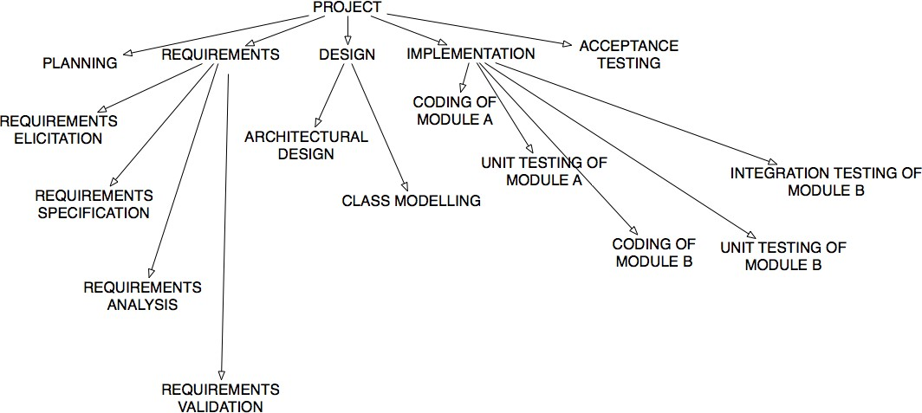
PROJECT ANALYSIS BY WORK BREAKDOWN STRUCTURES
Software Engineering
Project Management

Slide 23
WORK BREAKDOWN - THE 100% RULE
Software Engineering
Project Management
The 100% Rule...states that the WBS includes 100% of the work defined by the project scope and captures all deliverables - internal, external, interim -in terms of the work to be completed, including project management.

Slide 24
Purpose of Creating WBS
Software Engineering
Project Management
Improve accuracy of cost, time, and resource estimates.
Define a baseline for performance measurement and control.
Facilitate clear responsibility assignments.

Slide 25
Software Engineering
Project Management
Work Break Down Structure
displays and defines the product to be developed or produced by hardware, software, support, and/or service element, and relates the work scope elements to each other and to the end product(s).
A WBS, up to level 3, is developed during the proposal as level three of the WBS is the normal reporting level of external contractual information. Standards are to be followed if required by the customer (like U.S. government MIL-STD-881).
After Contract award, the Project Manager expands the WBS into a Contract Work Breakdown Structure (CWBS) as the initial step in the planning process.
WBS expansion will extend the CWBS a minimum of one level below the negotiated external reporting level. Why?
This sets up (1) the framework for work scope definitions and (2) assignments to the functional organizations.
One and only one CWBS exists for each contract and once created will exist for the life of the contract.
Only a formal contract change will effect a change in the WBS……

Slide 26
Work Breakdown Structure II
Software Engineering
Project Management
The WBS is used to report status externally to the customer. The CWBS is used internally to plan in detail and to collect status information on a periodic bases.
The Customer, not the contractor, is the primary owner of the WBS.
The CWBS is not a "people organization chart”; it is a “work scope chart”.
The resource charges must go directly into a single Task Plan element and not split between two or more Task Plan elements.
The WBS/CWBS will serve multiple functions (e.g. Design To Cost (DTC), Life Cycle Cost (LCC), Engineering Bill(s) of Material (EBOM), Manufacturing Bill (s) of Material (MBOM), as well as the product structure of the end items) in one format.
Never lose sight of the fact that the WBS is used for TECHNICAL PLANNING and STATUS ACHIEVEMENT.

Slide 27
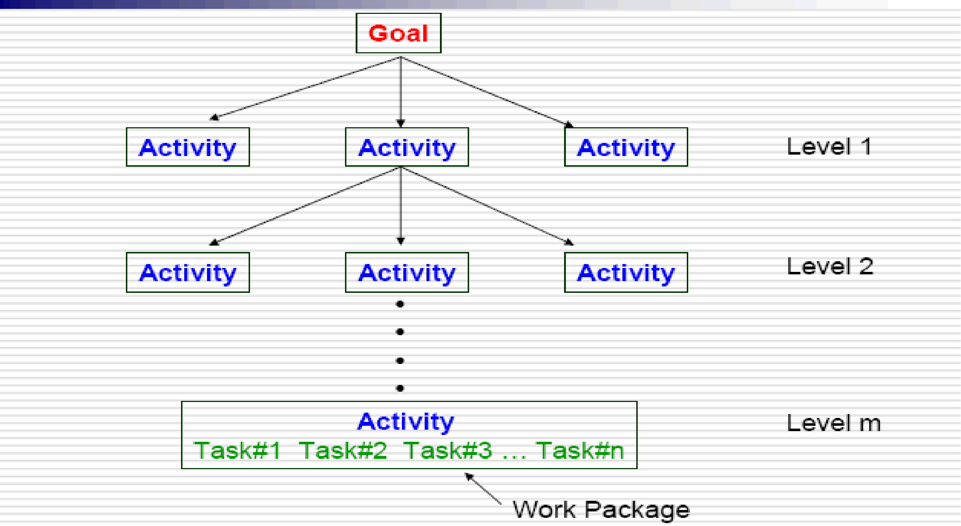
Hierarchy of WBS
Software Engineering
Project Management

Slide 28
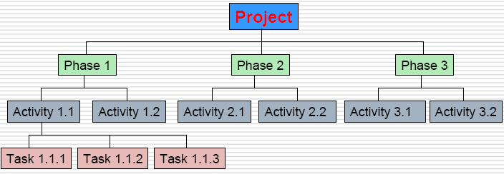
Design of WBS
Software Engineering
Project Management
A WBS is normally presented in chart form
The WBS should not be confused with the method of presentation
drawing an unstructured activity list in chart form does not make it a WBS.
Each item in the WBS is generally assigned a unique identifier
These identifiers are often known collectively as the code of accounts.
The items at the lowest level of the WBS are often referred to as work packages.
List-form WBS with 3 level code of account (Royce-144)
FAST NU
Spring, 2010

Slide 29
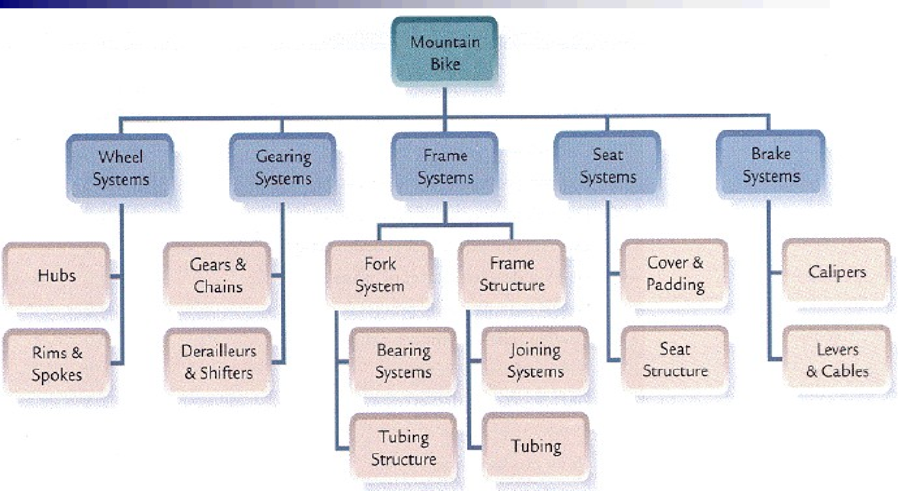
Product Based WBS
Software Engineering
Project Management

Slide 30
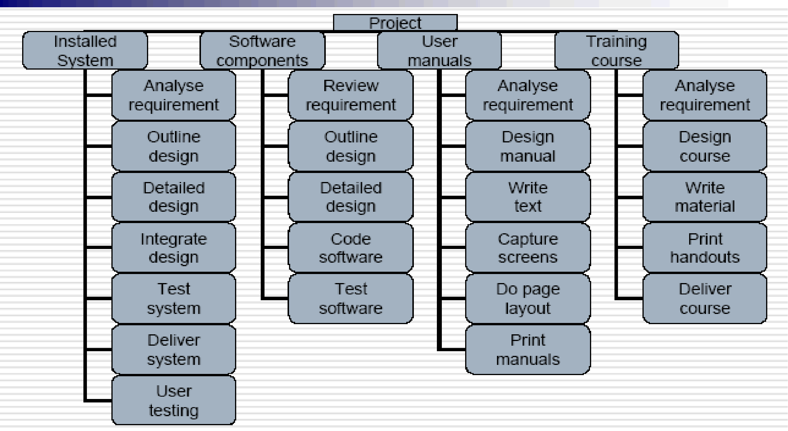
Deliverables Based WBS
Software Engineering
Project Management

Slide 31
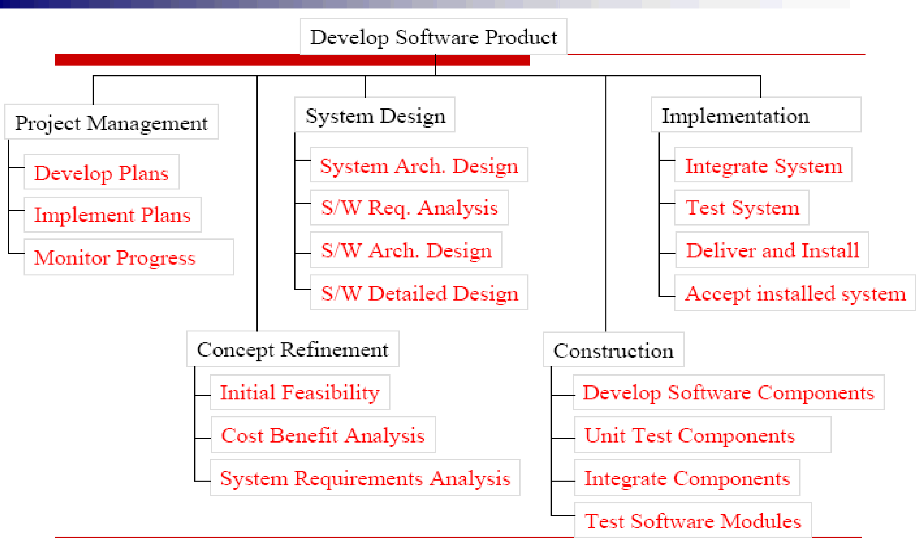
WBS Template for Software Development Project
Software Engineering
Project Management

Slide 32
WBS Framework
Software Engineering
Project Management
A framework dictating the number of levels and the nature of each level may be imposed on a WBS (e.g. IBM recommended five levels):
Level 1: Project.
Level 2: Deliverables (such as software, manuals and training courses)
Level 3: Components; Which are the key work items needed to produce deliverables (e.g. modules and tests required to produce the system software)
Level 4: Activities (Work-packages which are major work items, or collections of related tasks, required to produce a component)
Level 5: Tasks (tasks that will normally be the responsibility of a single person).

Slide 33
Activity Planning
Software Engineering
Project Management

Slide 34
Activity/Task List
Software Engineering
Project Management
Tasks (Leaves of WBS/PBS as Activity Plan ) and the precedence analysis (as Activity Sequencing) results in this management deliverable.
Example format: We can make first two columns and start working on the next two (durations estimation and precedence requirements in parallel).
Activity |  | Duration (weeks) | Precedents
A | Hardware selection | 6
B | Software design | 4
C | Install hardware | 3 | A
D | Code & test software | 4 | B
E | File take-on | 3 | B
F | Write user manuals | 10
G | User training | 3 | E,F
H | Install & test system | 2 | C,D

Slide 35
Precedence Analysis
Software Engineering
Project Management
Involves reviewing activities and determining dependencies
Mandatory dependencies: inherent in the nature of the work; hard logic (like testing after coding)
Discretionary dependencies: defined by the project
team; soft logic (Wait for feedback on prototype before detail design)
External dependencies: involve relationships
between project and non-project activities (e.g. supply of hardware)
You must determine dependencies in order to use critical path analysis

Slide 36
Network Planning Models
Software Engineering
Project Management
Approaches to scheduling; that achieve separation between the logical (relationships) and the physical (constraints/execution); use networks to model the project.
i.e. represent project’s activities and their relationships as a network.
first stage in creating a network model: represent the activities and their interrelationships as a graph.
Task Dependencies (relationships)
A
Finish-to-start (FS): Task (B) cannot start until task (A) finishes
Start-to-start (SS): Task (B) cannot start until task (A) starts
B
A
B
Finish-to-Finish (FF): Task (B) cannot finish until task (A) finishes
Start-to-finish (SF): Task (B) cannot finish until task (A) starts
A
B
A
B

Slide 37
Scheduling as precedence
Software Engineering
Project Management
F
S
A: Designing
A: Testing
B: Debugging
B: Coding S
S
F
S
A: Coding
B: Unit Testing
A: Release
B: Bug Fixing
F
F

Slide 38
Project Network Diagrams
Software Engineering
Project Management
Project network diagrams (PND) are the preferred technique for showing activity sequencing
A project network diagram is a schematic display of the logical relationships among, or sequencing of, project activities
Arrow Diagramming Method (ADM)
Also called activity-on-arrow (AOA) project network diagrams
Activities are represented by arrows
Nodes or circles are the starting and ending points of activities
Can only show finish-to-start dependencies
Precedence Diagramming Method (PDM)
Activities are represented by boxes
Arrows show relationships between activities
More popular than ADM method and used by project management software
Better at showing different types of dependencies

Slide 39
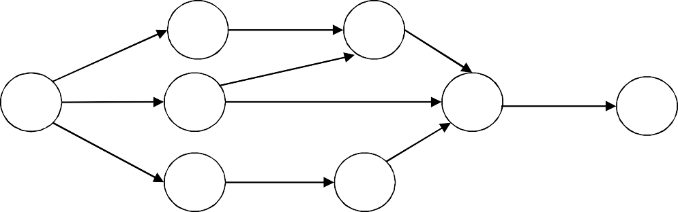
Software Enginee_{D}ring
Project Management
H
Basic Project Network Diagrams (PND)…..
AOA (ADM);
A=?
2
E
F
5
B=?
J
1
3
6
8
CPM adds more inf at nodes
C=?
I
4
G
7
A
Start: Finish: Res:
D
Start: Finish: Res:
PDM
ID:
Dur:
ID:
Dur:
H
Start: Finish: Res:
ID:
Dur:
B
Start: Finish: Res:
E
Start: Finish: Res:
ID:
Dur:
ID:
Dur:
J
Start: Finish: Res:
ID:
Dur:
F
Start: Finish: Res:
ID:
Dur:
C
Start: Finish: Res:
G
Start: Finish: Res:
I
Start: Finish: Res:
ID:
ID:
Dur:
ID:
Dur:
ID:
Dur:
Task Box of MS Project 2000: Activity Name Start:
Finish:
Dur:
Resource:

Slide 40
Network model
Software Engineering
Project Management
CPM
represents activities as links (arrowed lines) in the graph
nodes (circles) represent the events of activities start and finish.
Rules for CPM network construction
Nodes:
A project network may have only one start node (node 1) that designates the points at which the project may start. All activities coming from that node may start immediately; resources are available.
Network may have only one end node; designates the completion of the project and a project may only finish once.
Nodes are events have no duration (instantaneous points in time).
source node: event of the project becoming ready to start and
Sink node: is the event of the project becoming completed.
Intermediate nodes: represent two simultaneous events – the event of all activities (leading in to a node) having been completed and the event of all activities (leading out of that node) being in a position to be started.
A link represents an activity (and has duration)

Slide 41
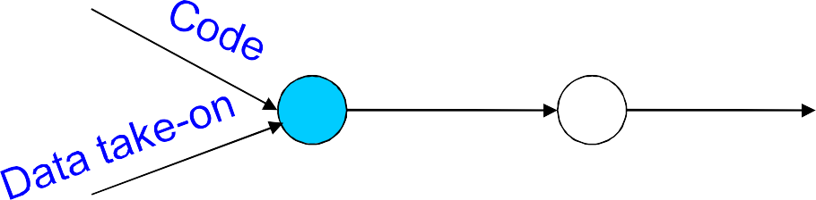
Examples:
Software Engineering
Project Management
Node 3 is an event indicates that both “Code’ and “Data take-on” have been completed and
“program Testing” can be started
Program Testing
Release
⁴ Program
3
Precedents are the immediate preceding activities
both activities “Code’ and “Data take-on” are called Precedents of “program Testing” (not of ”Release Program”) and;
“program Testing” is Precedent of ”Release Program”.
Time moves from left to right
Nodes are numbered sequentially

Slide 42
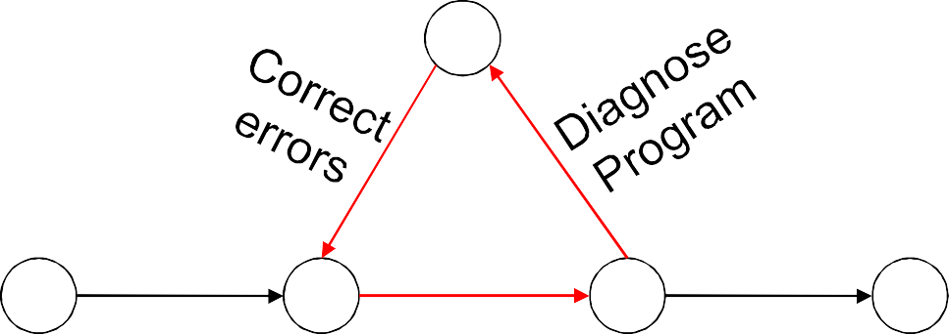
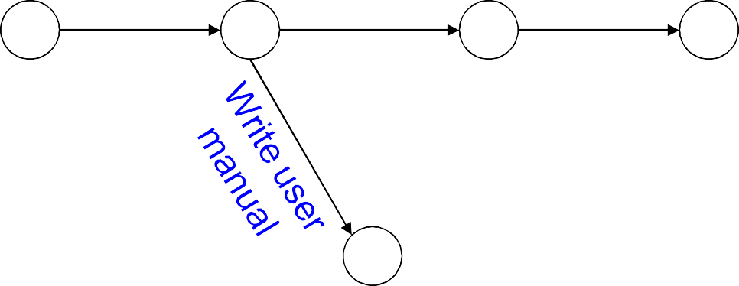
Software Engineering
Project Management
4
Network may not contain loops
If we know the # of times to repeat a set of activities (e.g. test- diagnose-correct) then we can draw that set a straight sequence, repeating it the appropriate number of times.
If we do not know then we cannot calculate the duration of the project.
Network may not contain dangles
A dangling activity such as “Write user manual” cannot exist, as it would suggest two completion points.
Code Program
Test Program
Release Program
1
2
3
5
A loop represents impossible sequence
Design Program
Code Program
Test Program
1
2
4
5
3

Slide 43
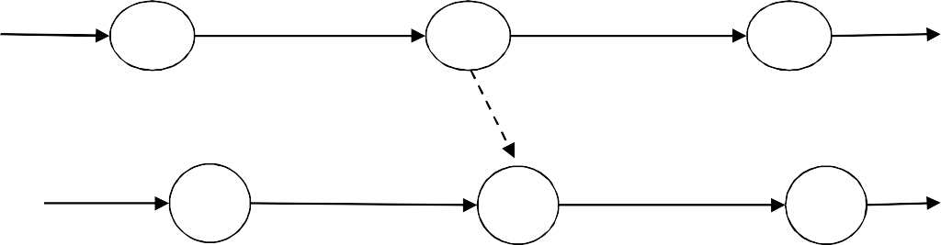
Using dummy activities
Software Engineering
Project Management
Two paths within a network have a common event although they are, in other respects independent, a logical error like the following might occur.
Practical Situation (Case1):
A:Specify hardware
C:Place
4
A > C (A precedent of C)
A, B > D (A & B precedent of D)
Network shows (incorrectly):
A, B > C, D (Both precedent of Both)
We can resolve this problem by separating the two (more or less) independent paths and introduce a dummy activity to link broken event (3). This effectively breaks unwanted link between “design data structure” and “place order”.
1
order
3
₂ B:Design Data
D:Code software
structures
5
Two paths with a common node.
Specify Place hardware
1
3 4
order
dummy
Design Data structures
Code software
2
3a
5
Two paths linked by a dummy activity

Slide 44
Software Engineering
Project Management
Dummy activities, shown as dotted lines in the network diagram, have a zero duration and use no resources.
Case 2: The use of a dummy activity where two activities share the same start and end nodes makes it easier to distinguish the activity end-points*
A
A
3
Dummy
4
2
3
1
B
B
Representing lagged activities
We might come across situations where we wished to undertake two activities in parallel but there is a lag between the two (time difference between start or finish).
Impossible to show (like “amendment recording” can start after “testing” and finish a little after the completion of “testing”).
It is better to show Each stage as a separate node.
Test prototype
Such parallel activities with a time lag between them are represented with pairs of dummy activities
1
3
1 day (SS)
Document
2 day (FF)
2
amendments
4

Slide 45
Precedence Networks (PN/PDM)
Software Engineering
Project Management
Where CPM networks use links to represent activities and nodes to represent events, precedence networks use boxes (nodes) to represent activities (known as work items) and links to represent dependencies.
The boxes may carry task descriptions and duration estimates and the links may contain a duration denoting a lag between the completion/start of the next.
It contains much more information than the CPM network and we do not need to keep a separate activity table.
Analysis of precedence networks proceeds in exactly the same ways.
An other advantage of PN is that they can represent parallel lagged activities (Which required use of dummy activities in CPM network) much more elegantly.
Parallel lagged activities in a precedence network.
Build Prototype
Test
Prototype
Revise specification
1
2
Document amendments

Slide 46
Sequencing and Scheduling activities
Software Engineering
Project Management
We require a schedule that clearly indicates when each of the project’s activities is planned to occur and what resources it will need.
We might present a schedule for a small project using a bar chart (next slide).
The chart shows taking account of the nature of the development process (i.e., certain tasks must be completed before others may start) and the resources that are available (e.g., activity C follows B as Ali cannot work on both simultaneously).
We have sequenced the tasks (i.e., identified the dependencies) and scheduled them (i.e., specified when they should take place).
For small projects, this combined sequencing-scheduling approach might be quite suitable, particularly where we wish to allocate individuals to particular tasks at an early planning stage.
On larger projects it is better to separate out these two activities: to sequence the task according to their logical relationships and then to schedule them taking into account resources and other factors.

Slide 47
Schedule for small Project: plan as a bar chart
Software Engineering
Project Management
Task | Weeks Person | 1 | 2 | 3 | 4 | 5 | 6 | 7 | 8 | 9 | 1 0 | 1 1 | 1 2 | 1 3 | 1 4 | 1 5
A | Ali
B | Ali
C | Ali
D | Akram
E | Aslam
F | Aslam
G | Aqib
A: Overall Design B: Specify Module 1 C: Specify Module 2 D: GUI Design
E: Code Module 1 F: Code Module 2 G: Testing Module 1
*Part-I concludes by Having:
Activity List and
Sequencing and
We continue for: In Part-II
Activity Resource Est
Activity Duration and
Scheduling
++

Slide 48
Activity Schedule
Software Engineering
Project Management
Activity Resource estimating (2004) ◄
Activity duration estimating
Schedule development
CPM (ideal plan)
Risk Analysis
Resource Allocation
Schedule control

Slide 49
Six Methods for Estimating Activity Duration
Software Engineering
Project Management
Estimating activity duration is challenging. You can be on familiar ground for some activities and totally unfamiliar ground for others.
Similarity to other activities
Historical data
Expert advice
Delphi technique
Three-point technique
Wide-band Delphi technique
Similarity to Other Activities (Analogy)
Activities in your WBS may be similar to ones already undertaken. Recollections of those activities and their duration can be used to estimate the present activity’s duration.
Historical Data
The recorded data becomes your knowledge base for estimating activity duration.
Orgs have recorded not only estimated and actual duration but also the characteristics of the activity, the skill set of the people working on it, and other
variables that they found useful.

Slide 50
Software Engineering
3. Expert Advice
Project Management
When the project involves a breakthrough technology or being used for the first time in the organization, there may not be any local experience or even professional skilled. In these cases, you will have to appeal to outside authorities.
4. Delphi technique
Can produce good estimates in the absence of expert advice.
This is a group technique that extracts and summarizes the knowledge of the group to arrive at an estimate.
Group members are asked (individually) to make their best guess of the activity duration. The results are tabulated and presented to the group in a histogram labeled 1st Pass.
Whose estimates fall in the outer quartiles are asked to share the reason for their guess. After listening to the arguments, each group member is asked to guess again. Results are presented as 2nd Pass.
Similarly a 3rd guess is made, and plotted.
First pass
Second pass
Third pass

Slide 51
5. Three-point Technique (PERT Est)*
Software Engineering
Project Management
The variation may be tightly grouped around a central value, or it might be widely dispersed.
In the first case, you would have a considerable amount of information on that activities duration as compared to the latter case, where you would have very litter or none.
You could make probabilistic statement about their likelihood in any case.
You need three estimates of activity duration: optimistic, pessimistic, and most likely.
Optimistic time as the shortest duration (one has had or might expect to experience if every thing happens as expected);
Pessimistic time is that duration that would be experienced (or has been experienced) if everything that could go wrong did go wrong and yet the activity was completed.
Finally, the most likely time is that time usually experienced.
O: Optimistic
P: Pessimistic M: Most Likely
6. Wide-Band Delphi Technique
Est = O+4M+P
6
Combining the Delphi and three-point methods results in the wideband Delphi technique.
It involves a panel, as in the Delphi technique. Members are asked, at each iteration, to give their optimistic, pessimistic, and most likely estimates for the
duration of the chosen activity.

Slide 52
Schedule development :Adding the time dimension
Moving from Logical to Physical network model:
we are now ready to start thinking about when each activity should be undertaken (Physically).
CPM
project network analysis technique used to predict total project Duration and concerned with two primary objectives:
Planning the project in such a way that it is completed as quickly as possible; and
Identifying those activities where a delay in their execution is likely to affect the overall end date of the project or ‘later activities’ start dates.
Network Analysis: The network is then analyzed by carrying out:
forward pass, to calculate the earliest dates at which activities may commence and the project be completed, and a
backward pass, to calculate the latest start dates for activities and the critical path.

Slide 53
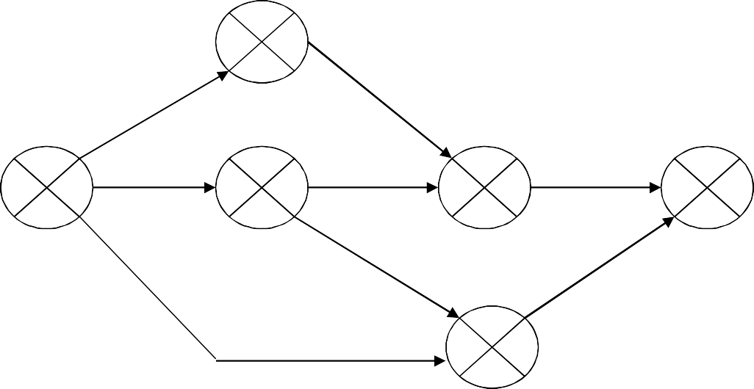
Constructing CPM Network
Typically information about events is recorded on the network (and activity- based information is generally held on a separate activity table).
common convention is to divide the node circle into quadrants to show the event number, the latest and earliest dates, and the event slack.
2
Event number
Latest
A=6
C=3
1
B=4
3
D=4
4
H=2
6
Earliest date
date
Slack
E=3
G=3
F=10
5
CPM node
The forward pass
carried out to calculate the earliest date on which each event may be achieved and the earliest dates on which each activity may be started and completed.
Earliest dates for events are recorded on the network diagram and for
activities on the activity table.

Slide 54
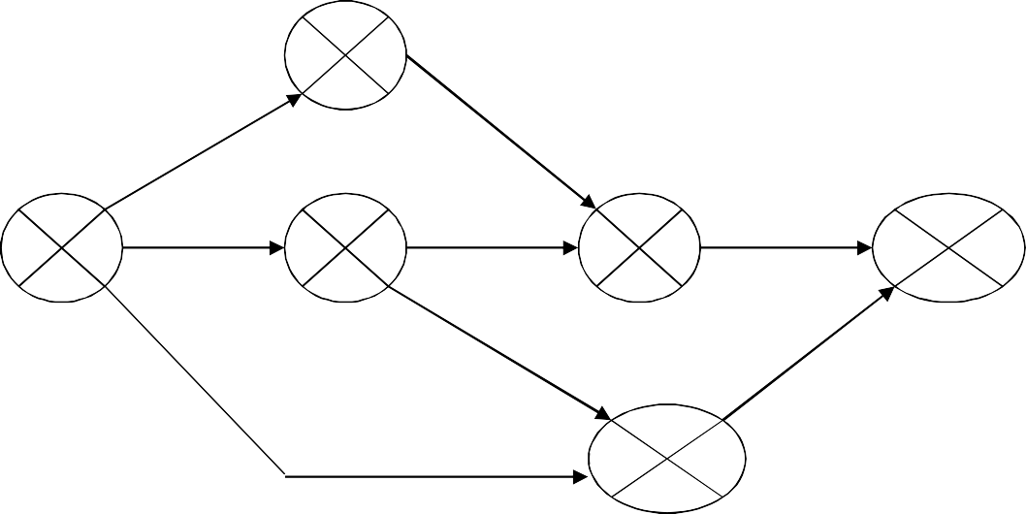
Forward Pass
₆ 2
A=6
C=3
CPM network after forward pass
₀ 1
B=4
₄ 3
D=4
?
₉ 4
H=2
6
13
?
E=3
?
G=3
F=10
10
5
Activity table after the forward pass
Activity | Duration (weeks) | Earliest start date | Latest start date | Earliest finish date | Latest finish date
A | 6 | 0 |  | 6
B | 4 | 0 |  | 4
C | 3 | 6 |  | 9
D | 4 | 4 |  | 8
E | 3 | 4 |  | 7
F | 10 | 0 |  | 10
G | 3 | 10 |  | 13
H | 2 | 9 |  | 11

Slide 55
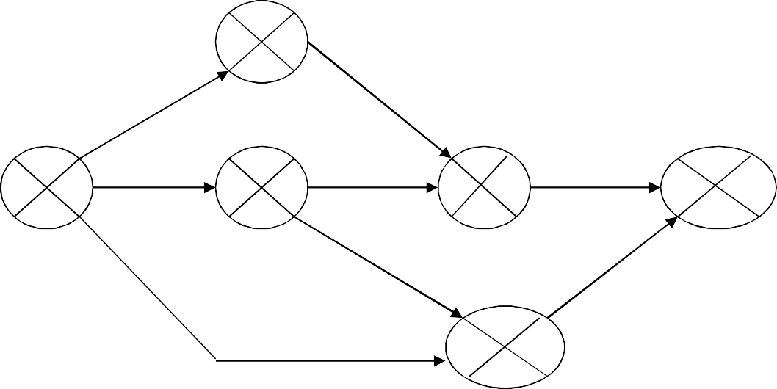
Backward Pass
Software Engineering
Project Management
to calculate the latest date at which each event may be achieved, and each activity started and finished, without delaying the end date of the project.
we assume that the latest finish date for the project is the same as the earliest finish date.
Rule:
The latest date for an event is the latest start date for all activities commencing from that event.
In case more activities, we take the earliest of the latest start dates for those activities. (e.g. latest start dates for A=2, B=3, F=0; and earliest
among all =0 for event#1)
6 ² 8
A=6
C=3
₀ 1 ₀
B=4
₄ 3 ₇
D=4
4
H=2
6
9 11
13 13
E=3
G=3
F=10
10
⁵ 10
CPM network after backward pass

Slide 56
Software Engineering
Up date the activity table
For Latest start and finish dates
Project Management
Activity | Duration (weeks) | Earliest start date | Latest start date | Earliest finish date | Latest finish date | Sla ck
A | 6 | 0 | 2 | 6 | 8 | 2
B | 4 | 0 | 3 | 4 | 7 | 3
C | 3 | 6 | 8 | 9 | 11 | 2
D | 4 | 4 | 7 | 8 | 11 | 3
E | 3 | 4 | 7 | 7 | 10 | 3
F | 10 | 0 | 0 | 10 | 10 | 0
G | 3 | 10 | 10 | 13 | 13 | 0
H | 2 | 9 | 11 | 11 | 13 | 2
Critical Path
A critical path for a project is the series of activities that determines the
earliest time by which the project can be completed
The critical path is the longest path through the network diagram and has the least amount of slack or float

Slide 57
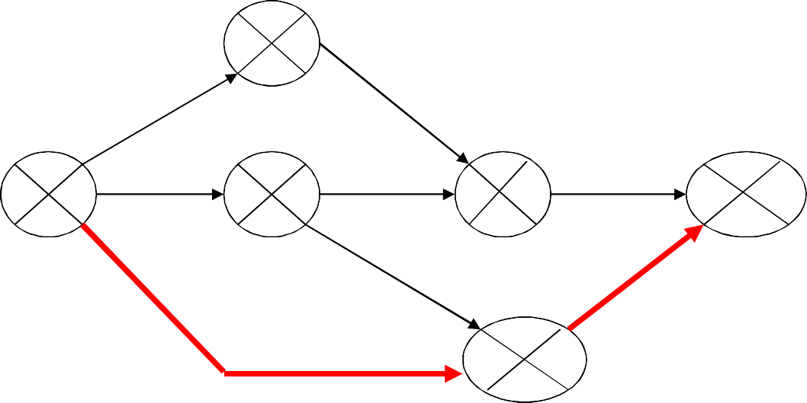
Software Engineering
The critical path
Project Management
Any delay on the critical path will delay the project.
Slack: The difference between the earliest date and the latest date for an event
– measure of how late an event may be without affecting the end date of the project.
Any event with a slack of zero is critical: any delay in achieving that event will delay the completion date of the project as a whole.
There will always be at least one path through the network joining those critical events – this path is known as the critical path.
significance of critical path is two-fold.
In planning: it is the critical path that we must shorten if we are to reduce the overall duration
In managing: must pay attention to monitoring activities on the critical path so that the effects of any delay or resource unavailability are detected at the earliest opportunity.
2
6₂ 8
A=6
C=3
1
0
B=4
3
D=4
4
H=2
6
0
0
4 ₃ ₇
9 11
13 13
2
0
E=3
G=3
F=10
5
10 ₀ 10
The Critical path

Slide 58
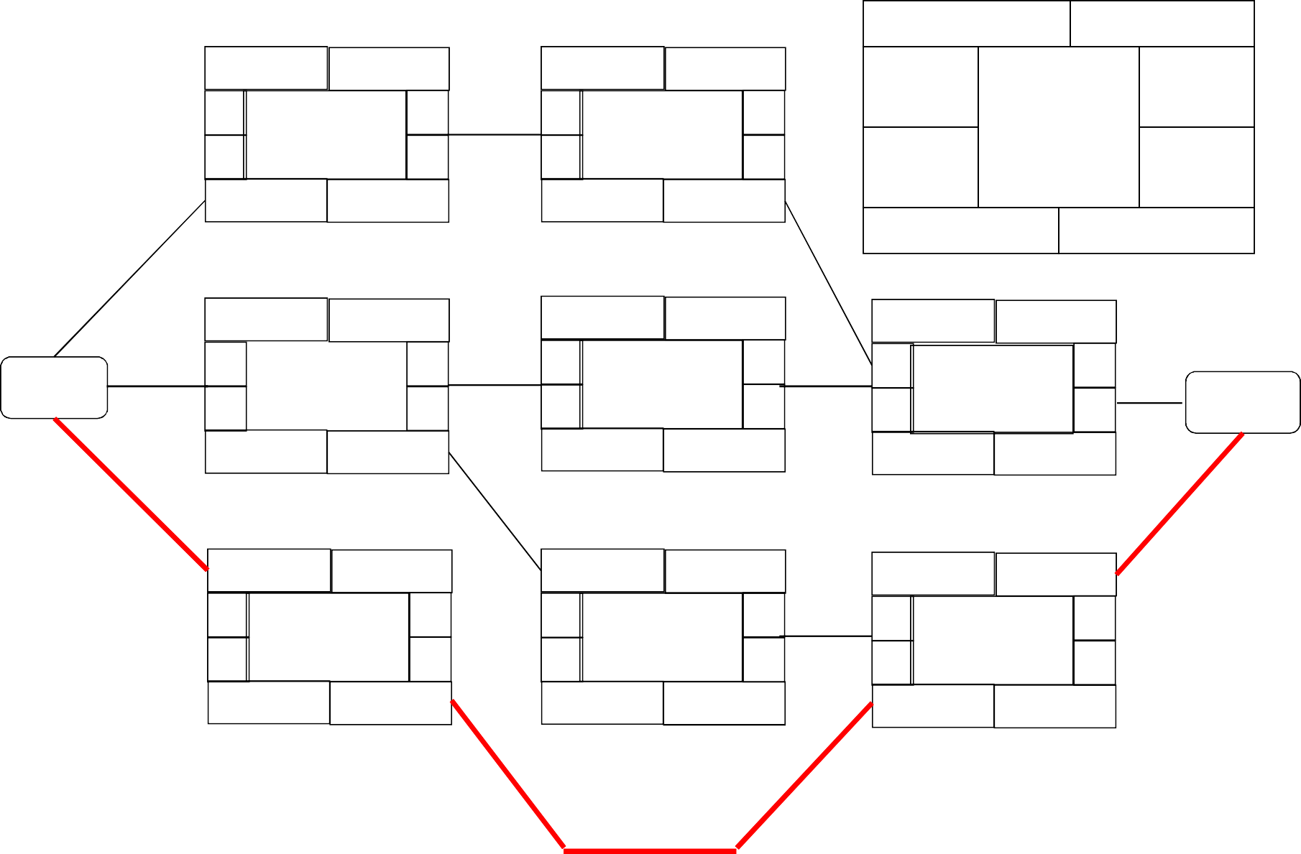
Precedence Network
Activity Label Earliest
Duration
Earliest
A 6 wks
0 Hardware 6
C 3 wks
6 Build 9
Start Latest Start
Activity Description
Finish Latest Finish
design
8 hardware 11
5 wks 2 wks
2 8
8 wks
2 wks
Activity Span
Float
D
4 Code
7 Software 11
H
9 Install & 11
11 test 13
B 4 wks
4 wks
8
2 wks
0 Software 4
7
Start
3
design
finish
7 wks
3 wks
7 wks 3 wks
4 wks
2 wks
F
0 User
0 manual
10 wks
E
4 File 7
7 Take-on 10
G
10
3 wks
3 wks
10
10
13
10 Training 13
User
10 wks
0 wks
6 wks
3 wks
3 wks
0 wks
The critical path through activities F and G is shown as a heavy line.

Slide 59
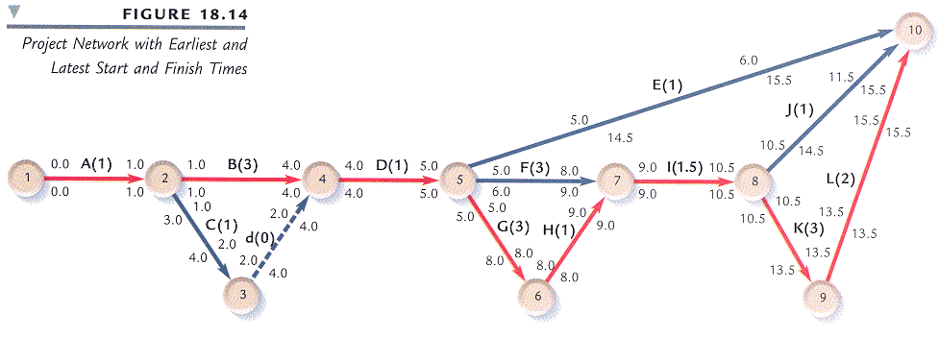
Alternative notation
Software Engineering Project Management

Slide 60
Gantt Chart
Software Engineering
Project Management
Activity Schedule and Staff allocation
4/7 1 1/7 18/7 2 5/7 1/8 8/8 15/8 2 2/8 2 9/8 5/9 12/9 19/9
Fred Jane Anne Jim Mary
 | T4
 |  |  |  |  | T8 |  |  |  |  |  |  |  | T11
 |  |  |  |  |  |  |  |  |  |  |  |  |  |  |  | T12
 | T1
 |  |  | T3
 |  |  |  |  |  |  |  | T9
 | T2
 |  |  |  |  |  | T6 |  |  |  | T10
 |  |  | T7
 |  |  |  |  |  | T5

Slide 61
Case Study: Portion of Detailed Schedule (ACIC)
Module | Program | Task | Duration (days) | Effort (days) | Start Date | End Date
- | - | Requirement | 8.89 | 1.33 | 7/10/00 8:00 | 7/21/00 17:00
- | - | Design review | 1 | 0.9 | 7/11/00 8:00 | 7/12/00 9:00
- | - | Rework after design review | 1 | 0.8 | 7/12/00 8:00 | 7/13/00 9:00
History | UC17 | View history of party details, UC17 | 2.67 | 1.87 | 7/10/00 8:00 | 7/12/00 17:00
History | UC7 | Code walkthrough UC17 | 0.89 | 0.27 | 7/14/00 8:00 | 7/14/00 17:00
History | UC19 | Code walkthrough UC19 | 0.89 | 0.27 | 7/14/00 8:00 | 7/14/00 17:00
* Why the duration is mostly > Effort

Slide 62
Module | Program | Task | Duration (days) | Effort (days) | Start Date | End Date
- | - | Rework after | 0.89 | 2.49 | 7/17/00 | 7/17/00
 |  | code |  |  | 8:00 | 17:00
 |  | walkthrough
- |  | Rework after | 0.89 | 0.71 | 7/18/00 | 7/18/00
 |  | testing |  |  | 8:00 | 17:00
History | UC17 | Test, UC 17 | 0.89 | 0.62 | 7/18/00 | 7/18/00
 |  |  |  |  | 8:00 | 17:00
History | UC19 | Test, UC 19 | 0.89 | 0.62 | 7/18/00 | 7/18/00
 |  |  |  |  | 8:00 | 17:00
Configuration | - | Reconciliation | 0.89 | 2.49 | 7/19/00 | 7/19/00
 |  |  |  |  | 8:00 | 17:00
Management | - | Scheduling | 7.11 | 2.13 | 7/10/00 | 7/19/00
 |  | and tracking |  |  | 8:00 | 17:00
Quality | - | Milestone | 0.89 | 0.62 | 7/19/00 | 7/19/00
 |  | analysis |  |  | 8:00 | 17:00

Slide 63
Project Monitoring and Control
Software Engineering
Project Management
63

Slide 64
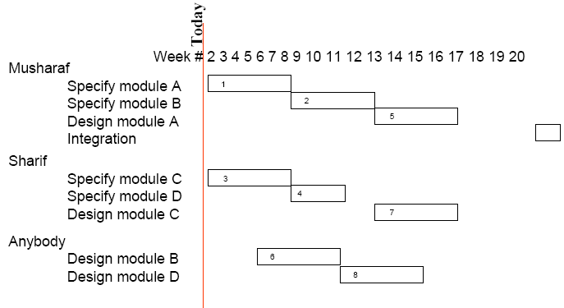
Project Progress Monitoring
Software Engineering
Project Management
(1) The Gantt Chart
Updated chart regularly with a ‘today cursor’ provides an immediate visual indication of which activities are ahead or behind schedule.
Dr. Arshad A Shahid
FAST NU
Spring, 2010
64

Slide 65
The Gantt Chart
Software Engineering
Project Management
Today
Week # 2 3 4 5 6 7 8 9 10 11 12 13 14 15 16 17 18 19 20
Musharaf
Specify module A Specify module B Design module A Integration
1
2
5
Sharif
Specify module C Specify module D Design module C
3
4
7
Anybody
Design module B Design module D
6
8
Activity 2 Ahead, 4 completed ahead, 6 behind

Slide 66
(2) Project Slip Chart
Software Engineering
Project Management
Today
Week # 2 3 4 5 6 7 8 9 10 11 12 13 14 15 16 17 18 19 20
Musharaf
Specify module A Specify module B Design module A Integration
1
2
5
Sharif
Specify module C Specify module D Design module C
3
4
7
Anybody
Design module B Design module D
6
8

Slide 67
Categories of reporting
Software Engineering
Project Management
Report type | Examples | Comments
Oral formal regular | Weekly or monthly progress meetings | While reports may be oral formal written minutes should be kept
Oral formal ad-hoc | End-of-stage review meetings | While largely oral, likely to receive and generate written reports
Written formal regular | Job sheets, progress reports | Normally weekly using forms
Written formal ad-hoc | Exception reports, change reports
Oral informal | Canteen discussion, social interaction | Often provides early warning; must be baked up by formal reporting

Slide 68
Monthly Project Status Reports
Software Engineering
Project Management
General Information:
Agency name: Fast House, Pakistan | Date: May 04, 2001
Contact Name: Professor | Phone: 111-128-128
Project ID: 786 | For the period beginning: April 01, 2009 and ending: April 30, 2009
Name of the project: Political System of Pakistan
Project Start Date: August 14, 1947 | Current Phase: Struggling
Key Milestones for the Overall Project revised on <date>:
Milestone | Original Date | Revised Date | Actual Date
Milestones Planned for this month and Accomplished this month
Planned for Next Month
Not completed

